Slide 1

Introduktion til programmering

Slide 2
Program
08:30 — Velkomst praktisk
09:00 — Installer Java og IntelliJ
10:00 — Pause
10:15 — Hello World! Opgaver i studiengruppe
11:00 — Compiler
11:30 — Opsamling og forberedelse til næste gang

Slide 3
Praktisk
Fronter: https://kea-fronter.itslearning.com/
Gitbook: https://kea-class.gitbook.io/data-gbg-e24c-1
Link til gratis bog: https://books.trinket.io/thinkjava/
Linkedin Learning Java kursus: https://www.linkedin.com/learning/learning-java-17/
Oracle docs & materiale: https://dev.java/learn/

Slide 4
Hvad vi skal gennemgå i dag
- Hvad er:
- Programmering
- Java
- main()
- “Hello World!” med Java
- Terminal
- IntelliJ

Slide 5
Installere Java & IntelliJ
Installeringsguides findes på Fronter
Hvis du er hurtig eller allerede har installeret så benyt chancen for at hjælpe din medstuderende

Slide 6
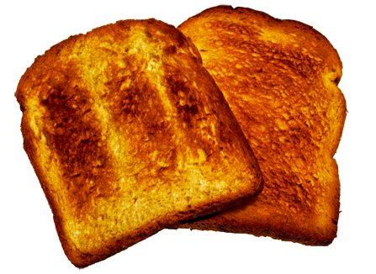
Programmering

Slide 7
Java er:
Class based / Object oriented
General purpose / High level
Write Once Run Anywhere
Compiler til bytecode

Slide 8
Compiler til bytecode
Java applications are typically compiled to bytecode that can run on any Java virtual machine (JVM) regardless of the underlying computer architecture. The syntax of Java is similar to C and C++, but has fewer low-level facilities than either of them.
https://en.wikipedia.org/wiki/Java_(programming_language)

Slide 9
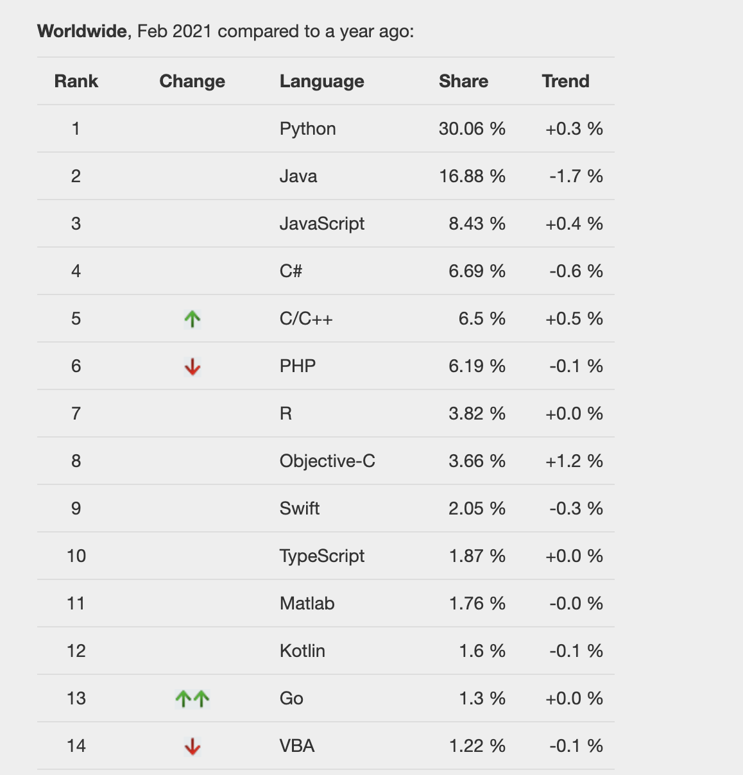
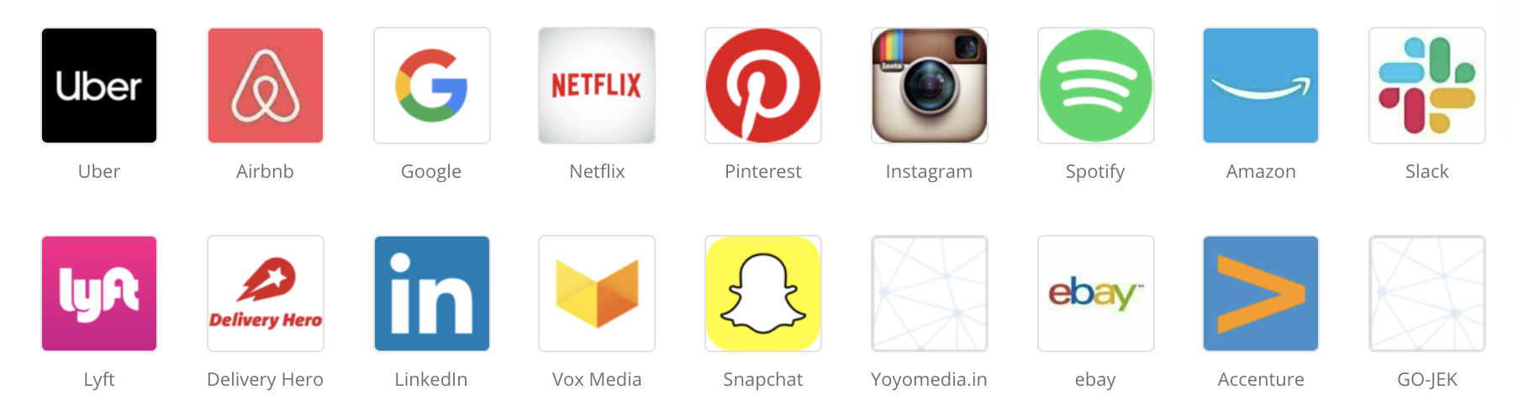
Populær:
Nr. 2 meat populære sprog ved PopularitY of Programming Language Index (PYPL) søgning på google
Anvendt bredt i industrien
https://pypl.github.io/PYPL.html

Slide 10
Deler vandene …
“There are only two kinds of languages: the ones people complain about and the ones nobody uses.”
Bjarne Stoustrup, author of C++

Slide 11

Class-based & object oriented
CLASS
Pokemon
OBJECTS
Name
PROPERTIES
Type
Weaknesses
METHODS
Run
Train

Slide 12
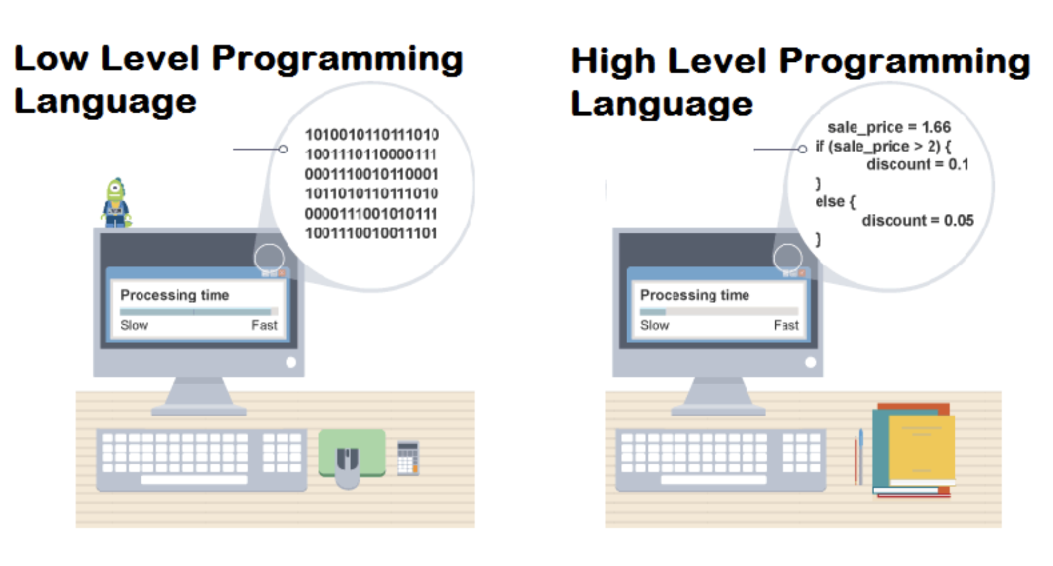
General purpose & High Level

Slide 13
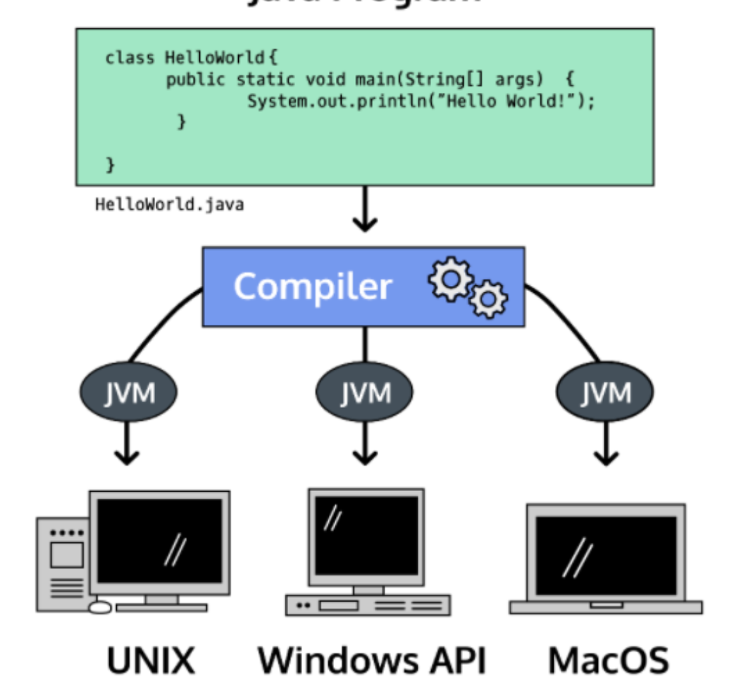
Write Once
Run Anywhere &
Compiled til Bytecode

Slide 14
public class Main {
public static void main(String[] args) {
System.out.println("Hello World!");
}
}

Slide 15
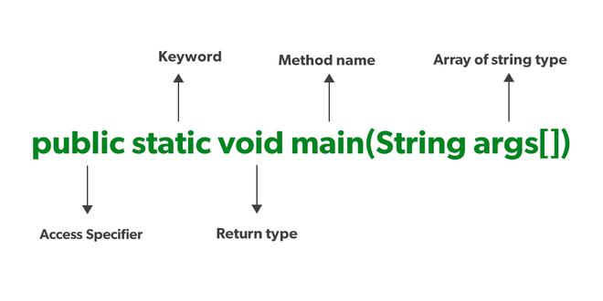
main
public = access modifier gør metoden tilgængelig overalt i din application
static = sørger for at gøre din metode til en class method i stedet for en instance method - uden at du behøver instanciere den først
void = metoden må ikke returnere noget - andet en void
main() = giver programmet et start punkt, kan ikke udføres uden

Slide 16
Øvelse:
I studiegrupperne:
Skriv, compile og run: Hello World

Slide 17
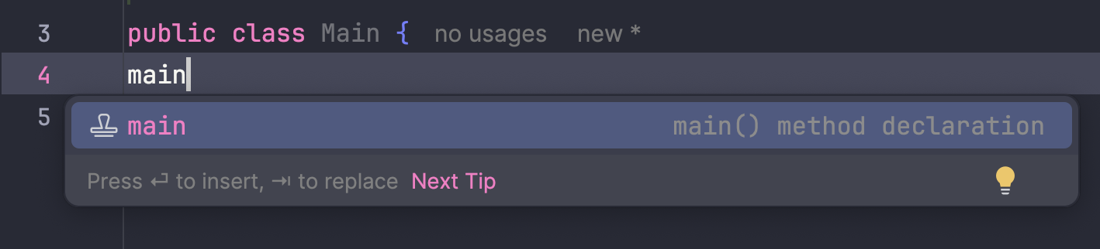
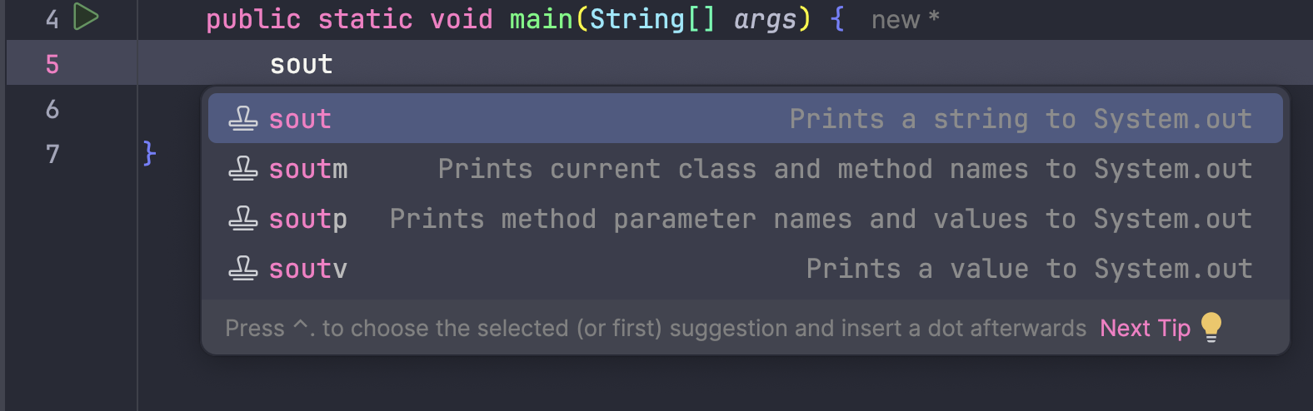
Shortcuts
main giver public static void main
sout giver System.out.println();

Slide 18
Bonus: Java spy commercial
https://www.youtube.com/watch?v=NVuTBL09Dn4

